Slide 1



Comprehensive Football Analysis:
Insights & Strategic Recommendations
By
Kalaimani Muthu

Slide 2


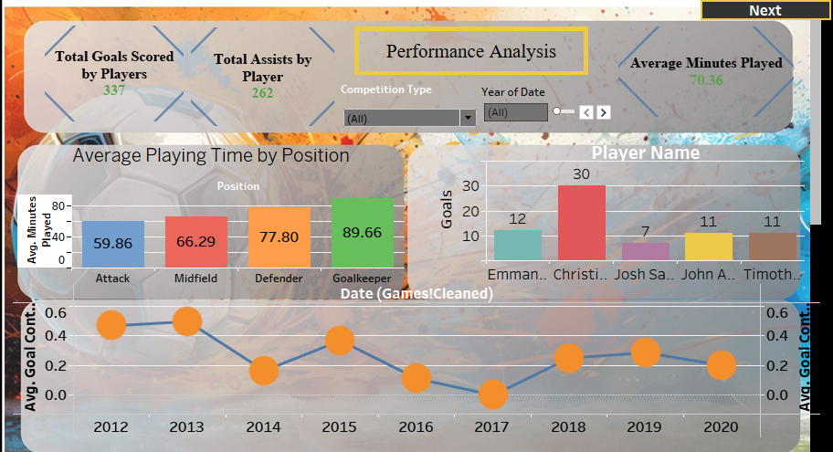

Slide 3
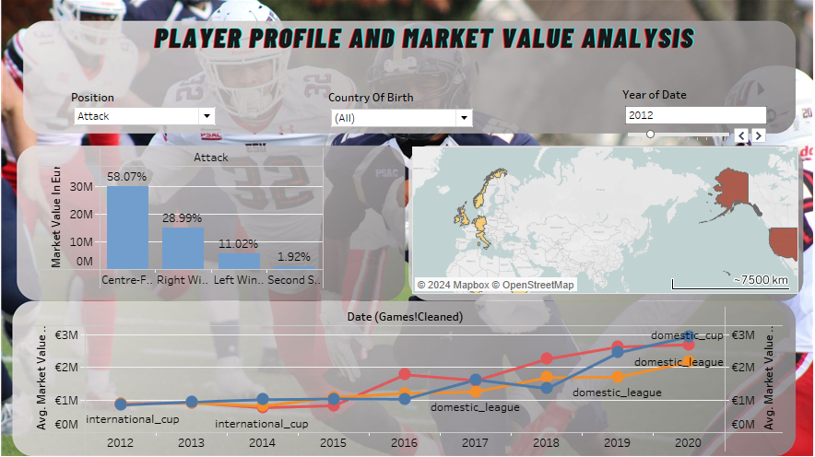

Slide 4
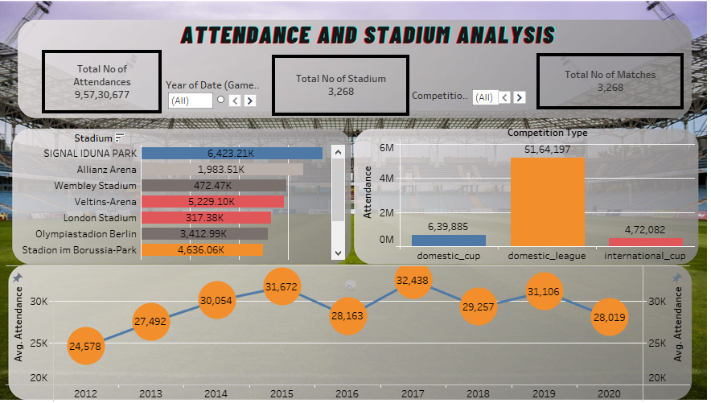

Slide 5
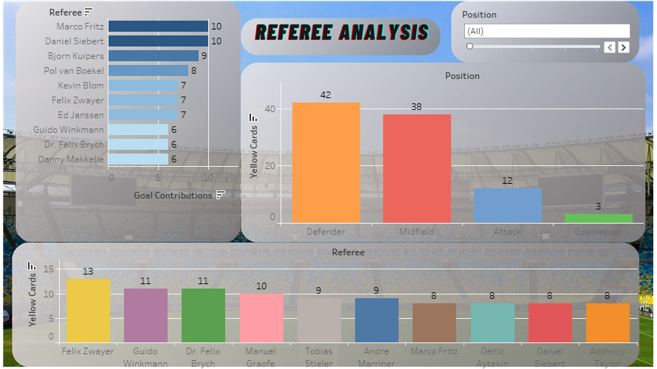

Slide 6
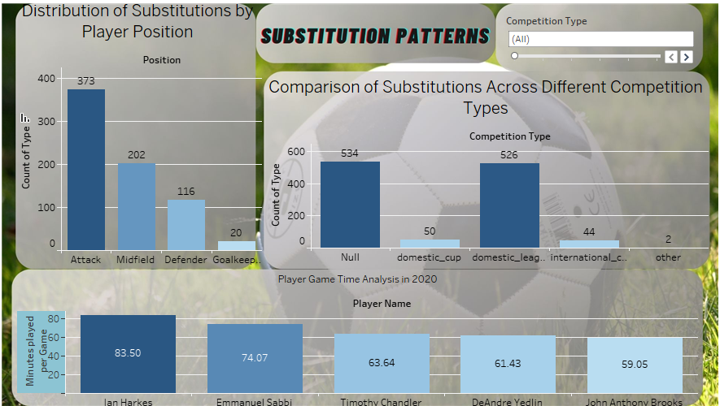

Slide 7
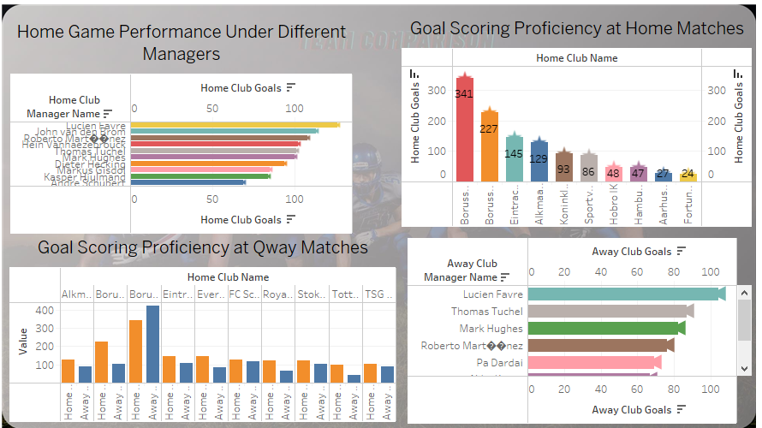

Slide 8
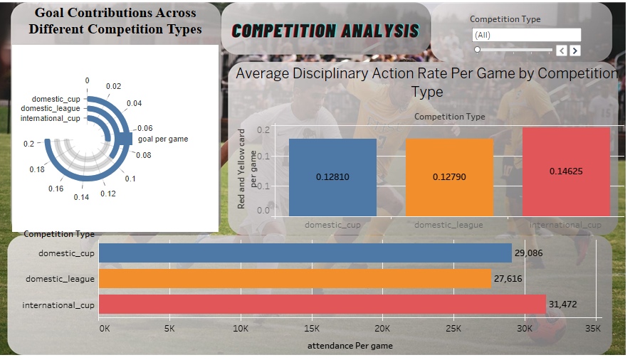

Slide 9
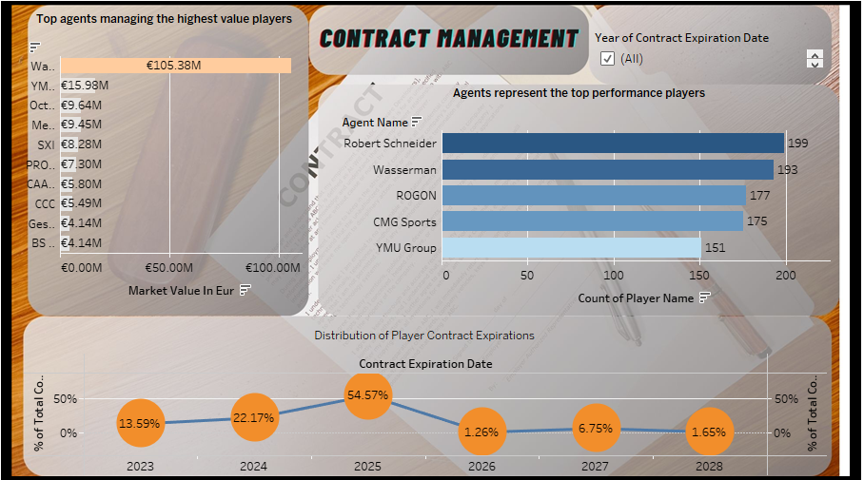

Slide 10
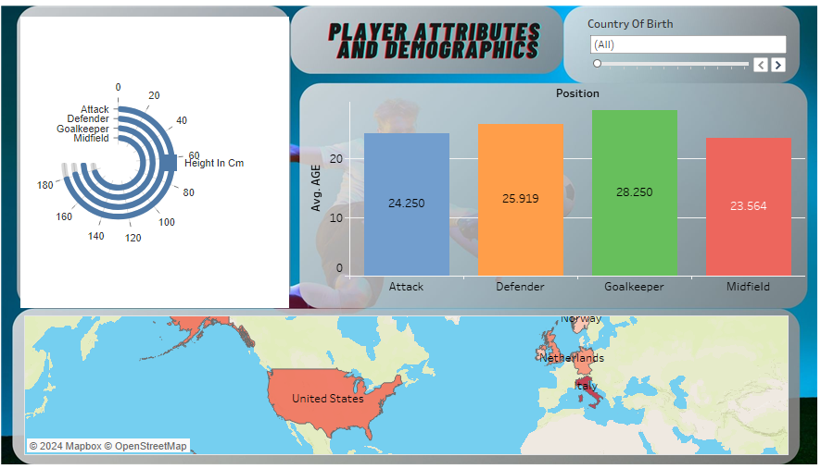

Slide 11
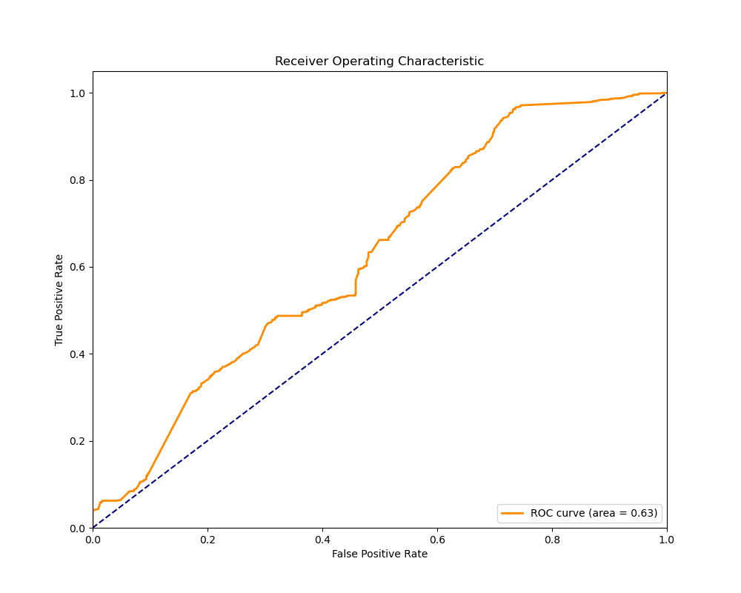
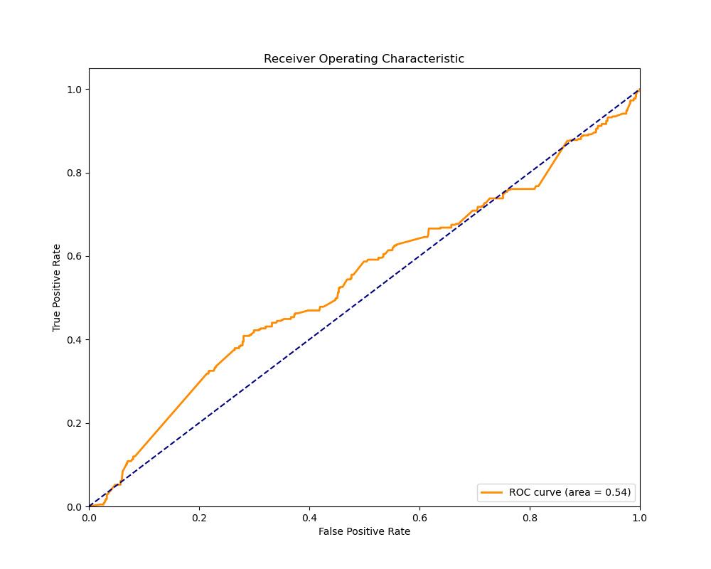
Model Analyses Summary
Logistic Regression (Predicting Starting Lineup from Goals Scored)
• ROC Curve (Chart 1): Shows moderate predictive ability with an AUC of 0.627.
Model Analyses Summary
Logistic Regression (Predicting Yellow Card from Previous Cards)
• ROC Curve (Chart 2): Slight improvement in prediction with AUC of 0.642.

Slide 12
Simple Linear Regression (Predicting Market Value from Scoring Frequency)
Model Performance:
Intercept: 0.0083
Coefficient for Scoring Frequency: 0.02749
R² Value: 0.00224 (Very low, indicating that scoring frequency alone does not explain variations in market value effectively)
Errors: Mean Squared Error of 0.957, Mean Absolute Error of 0.779, Root Mean Squared Error of 0.978
Multiple Linear Regression (Predicting Market Value from Various Features)
Model Performance:
Intercept: 0.0032
Coefficients: Height (-0.00747), Minutes Played (0.11474), Goals (-0.16384), Other feature (0.01855)
R² Value: 0.04407 (Low, suggesting that these features together explain only a small portion of the variance in market value)
Errors: Mean Squared Error of 0.927, Mean Absolute Error of 0.748, Root Mean Squared Error of 0.963

Slide 13
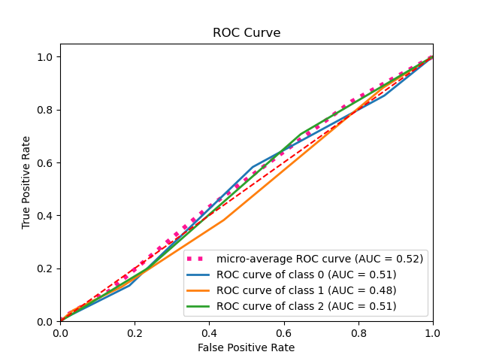
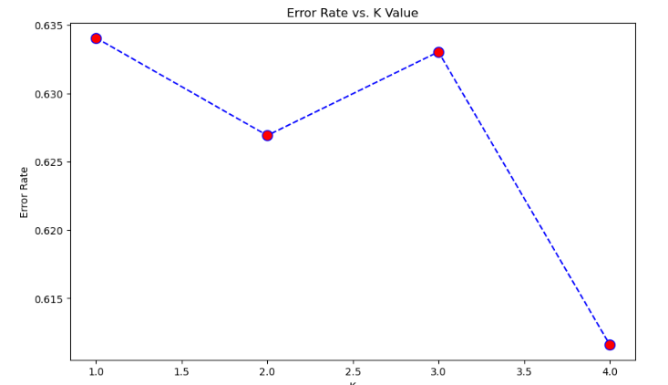
KNN Classification (Attendance Categories)
Minimum error: 0.6388888888888888 at K = 2
Optimal K = 2
Classifier n_neighbors: 2
Sample predictions: [0. 2. 1. 0. 0. 1. 0. 2. 1. 1.]
Accuracy: 0.3611111111111111
Recall: 0.3611111111111111
F1 Score: 0.3611111111111111
Precision: 0.3611111111111111
classification_report:
precision recall f1-score support
0.0 0.37 0.64 0.47 163
1.0 0.39 0.26 0.31 170
2.0 0.18 0.06 0.09 99
accuracy 0.36 432
macro avg 0.31 0.32 0.29 432
weighted avg 0.33 0.36 0.32 432

Slide 14
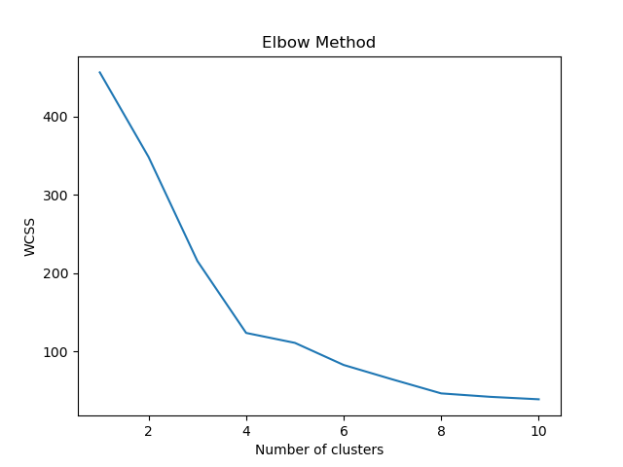
Kmean
MSE: 0.9269670026196399
RMSE: 0.9627912559945899
R² score: 0.04407255379719721
The average silhouette score is : 0.4727793028522318

Slide 15
Key Findings and Insights
Performance Analysis:
Predictive accuracy for starting lineup based on goals scored is modest (AUC = 0.63).
Attendance Analysis:
Classification accuracy for predicting match attendance categories is low (38.84%).
Player Demographics:
Physical attributes such as height and footedness reveal distinct player groups, aiding in personalized training strategies.

Slide 16
Recommendations Table:
Focus Area | Current Metric | Target Improvement | Expected Benefit
Model Prediction Accuracy | AUC: 0.63 | +59% to AUC: 1.00 | Significantly enhanced predictive reliability
Attendance Prediction | Accuracy: 38.84% | +61.16% to 100% | Highly targeted marketing and operational planning
Player Cluster Utilization | Silhouette Score: Low | Improve score by 50% | Refined player role identification and team dynamics

Slide 17
Business Conclusions
Average playing time varies by position, with goalkeepers at 89.66 minutes and attackers at 59.77 minutes.
Market value insights reveal midfielders at the highest (€86.29M) and goalkeepers at the lowest (€23.85M).
Total attendances reached over 9.5 million across all matches analyzed.
Strategic Recommendations:
Utilize position-specific training regimens based on playing time insights.
Reassess market valuation frameworks, especially for goalkeepers.
Machine Learning Models:
Logistic Regression:
Starting Lineup Prediction: Accuracy was 64%, with precision varying significantly between predicting starters (63%) and non-starters (94%).
Yellow Card Prediction: High precision (87%) but extremely low sensitivity for predicting actual yellow card occurrences.
Recommendations: Integrate more game-specific data points (like opposition and match stakes) to enhance predictive accuracy.
Linear Regression:
Market Value from Scoring Frequency: Extremely low explanatory power (R² = 0.002).
Market Value from Multiple Features: Slightly better with an R² of 0.044.
Recommendations: Broaden the feature set to include non-performance metrics like media presence and sponsorship value.
KNN Classification:
Attendance Categorization: Low overall accuracy (36.1%) with the best performance at K=2.
Recommendations: Experiment with other classification methods that might capture complex patterns more effectively, such as Random Forests or Gradient Boosting Machines.
K-Means Clustering:
Player Grouping: Identified clusters based on physical attributes but lacked strong distinctiveness.

Slide 18
Thank You

